Slide 1
EXQUISITE EVENT PLANNER BY GANAPATHY SUBRAMANIAN AND SAAIRAAM
Notes:
This presentation demonstrates the new capabilities of PowerPoint and it is best viewed in Slide Show. These slides are designed to give you great ideas for the presentations you’ll create in PowerPoint 2010!
For more sample templates, click the File tab, and then on the New tab, click Sample Templates.

Slide 2
1
2
3
FEATURES OF OUR PROJECT
TASKS
GIVEN
FINAL RESULTS
We have features for every step of the way

Slide 3
Features of our Project
1
Details of the Project

Slide 4
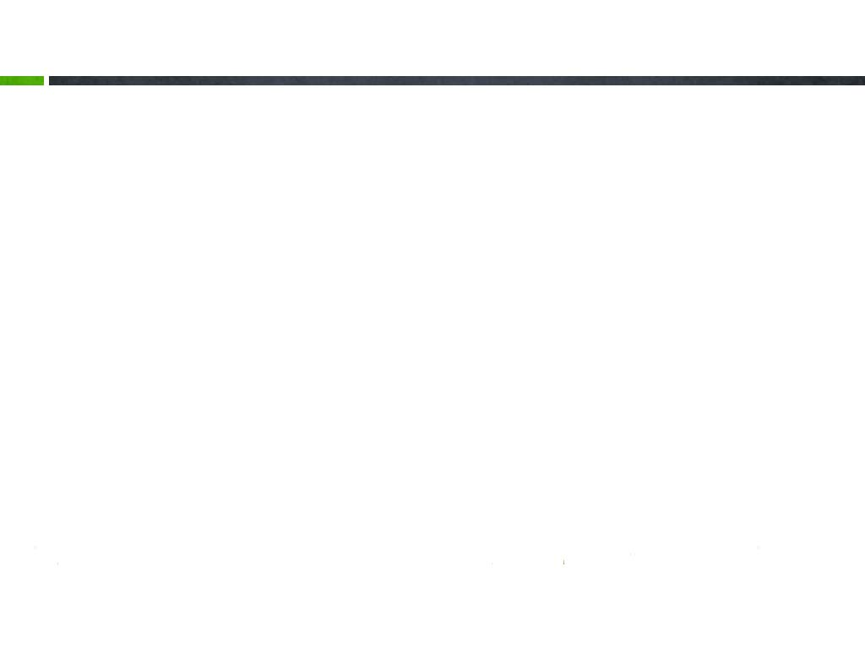


Getting Started with Templates
We have integrated our payment gateway with Paytm
We have different kind of roles (Admin, Superadmin, Subadmin , normal User)

Slide 5


Frontend
The admin can able to add/remove/edit entities from the respective database tables from the frontend, this removes the extra work of inserting values every time into database when there is a new data
Frontend Features

Slide 6






TECHNOLOGIES USED
FRONTEND
JSP
CSS
AJAX
BOOTSTRAP
JAVASCRIPT
BACKEND
SPRING BOOT REST API
JPA REPOSITORY
MY-SQL
SERVICES
SMS - TWILIO
EMAIL – SPRING BOOT EMAIL CONFIGURATION
PAYMENT – PAYTM
PDF – OPENPDF
EXCEL – POI-OOXML

Slide 7

TASKS GIVEN
2

Slide 8


Tasks given
Sms
Email
PDF generation
Excel generation
MVC architecture
Authentication
Spring boot
JPA repository

Slide 9
FINAL RESULT
3

Slide 10
THE TASKS WE HAVE DONE!
USER SIDE
We have use the email service for the contact us as well as for the forgot password
The users will book their hotels , caters and add-ons in the bookings form
The users then wait for the admin to accept the booking
After the admin accepts the booking , the user will be given the button “pay”
This pay button will go to the paytm webpage
The paytm webpage login credentials are 77777 77777 and password: Paytm12345 and OTP: 489871
After paying the amount with paytm then the user will be able to download the bill as a pdf

Slide 11
THE TASKS WE HAVE DONE!
ADMIN SIDE (admin,subadmin,superadmin)
The admin has control over all data in the database from the frontend
There are 3 types of admins – Admin, Super Admin, Sub Admin
The admin can able to add, delete, edit the details of all table contents
The superadmin can able to add and edit the details of Hotel,Catering,Vendors,events and manage the booking details
The subadmin can only able to add and edit the details of Hotel,Catering,Vendors and events
The admin can download the excel sheet for booking details from the database

Slide 12

Screen shots

Slide 13


Slide 14
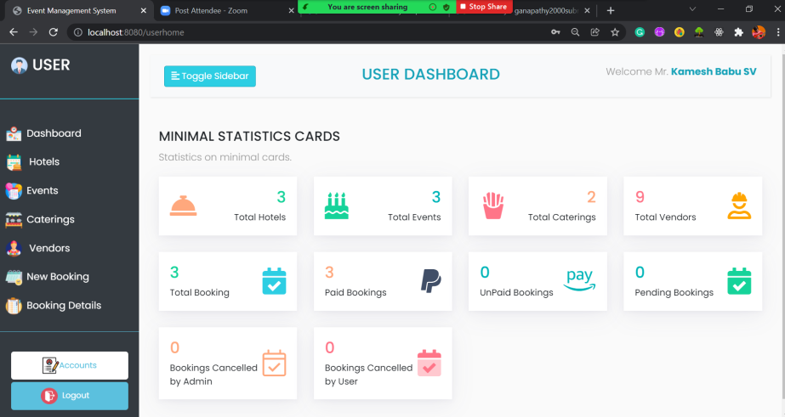

Slide 15
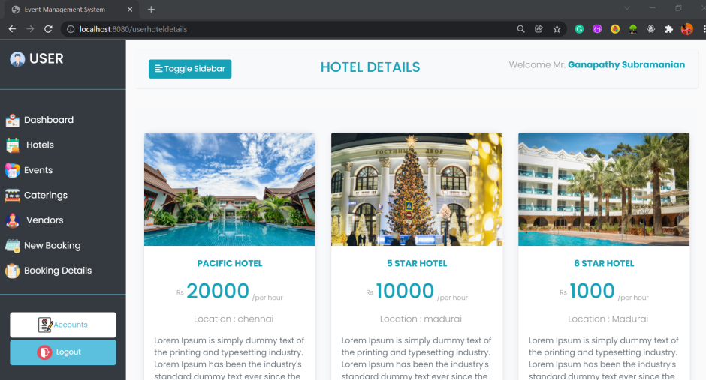

Slide 16
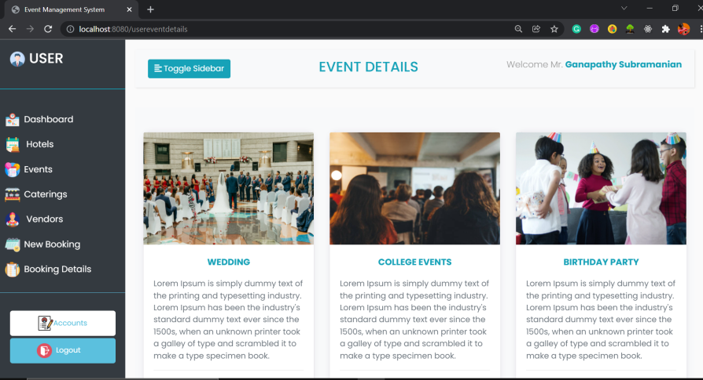

Slide 17
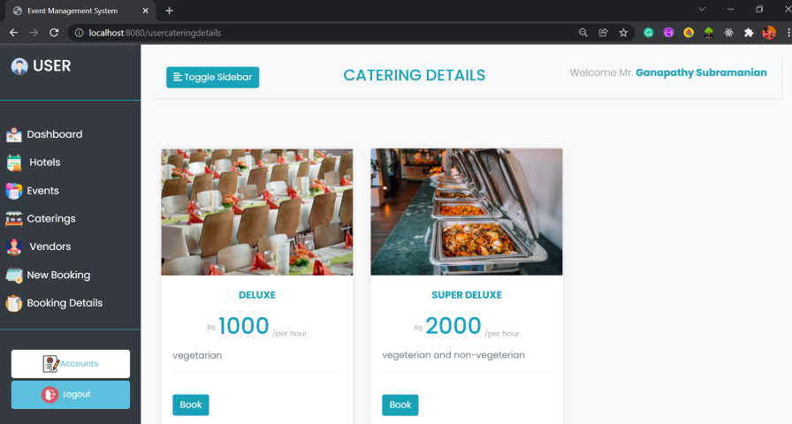

Slide 18
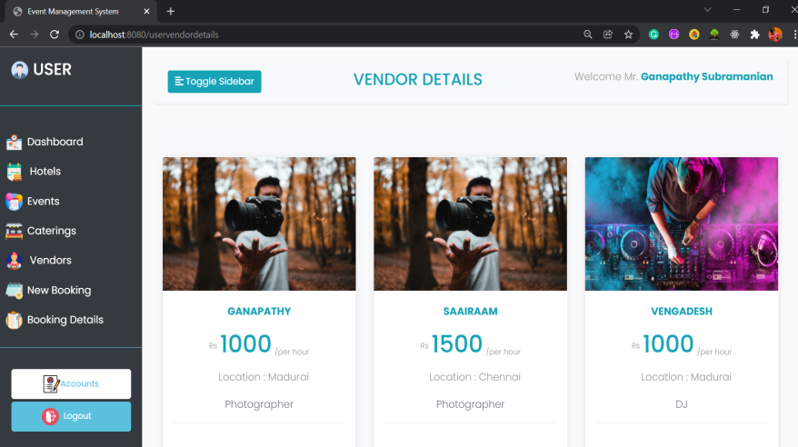

Slide 19
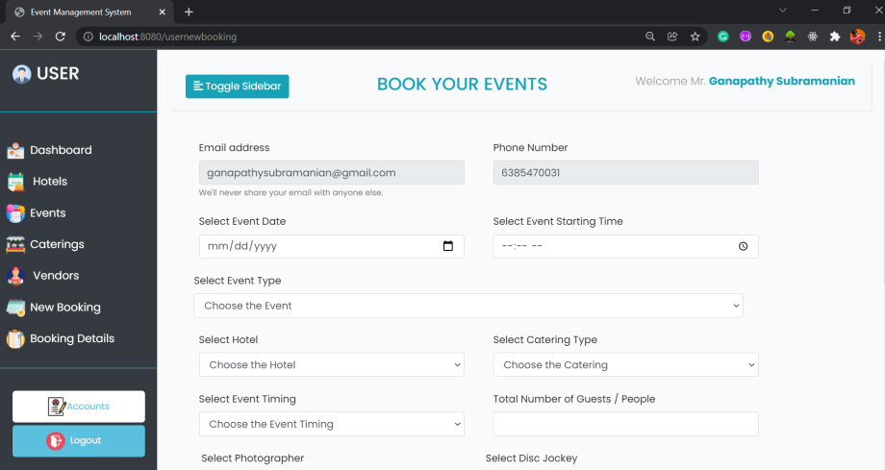

Slide 20
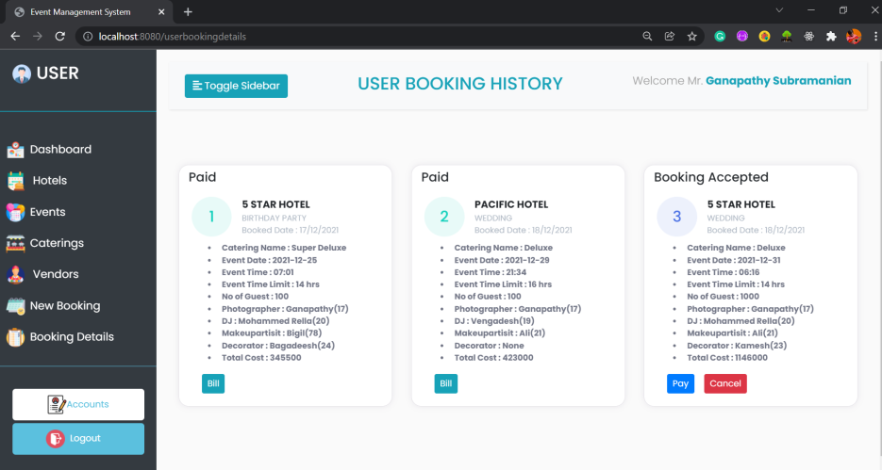

Slide 21
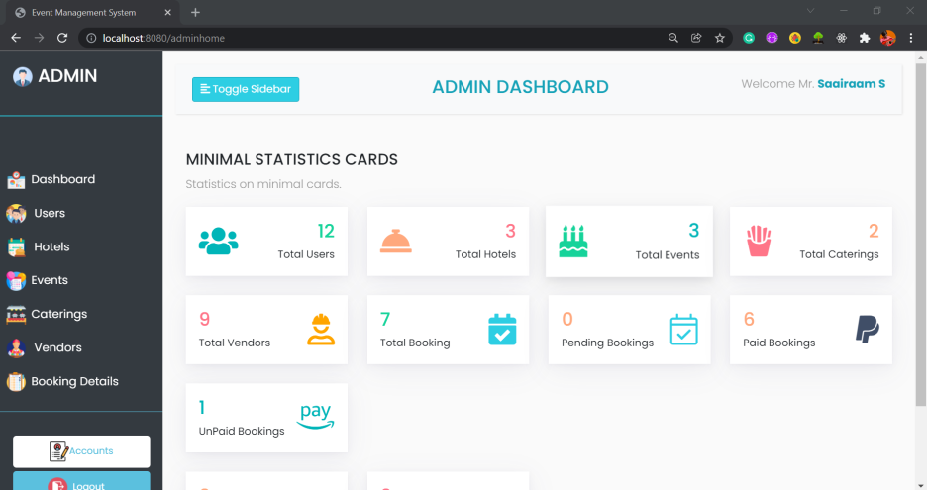

Slide 22
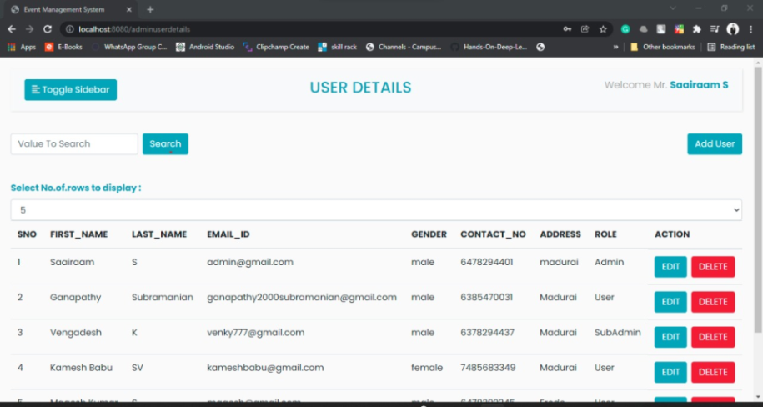

Slide 23
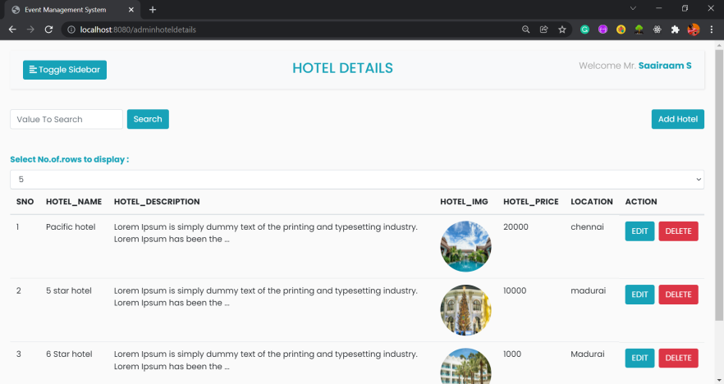

Slide 24
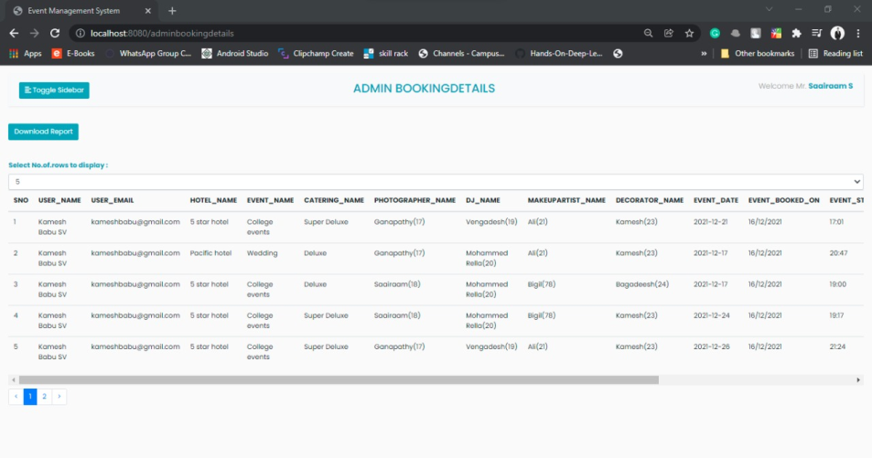

Slide 25
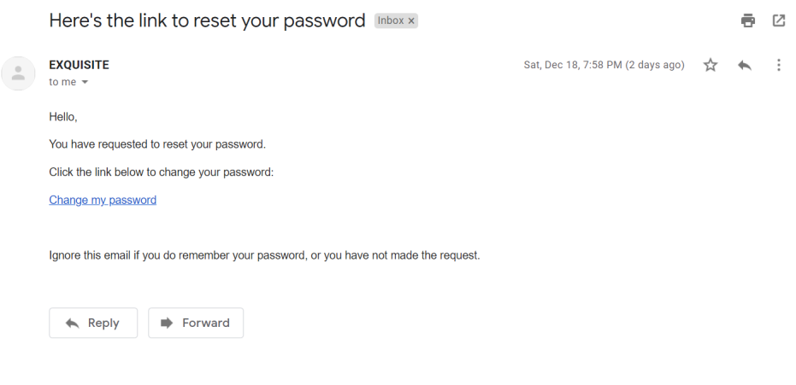

Slide 26
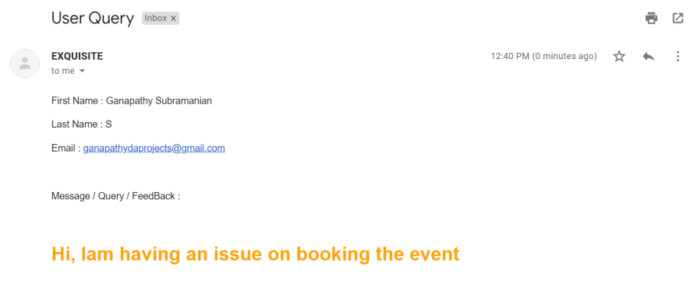

Slide 27
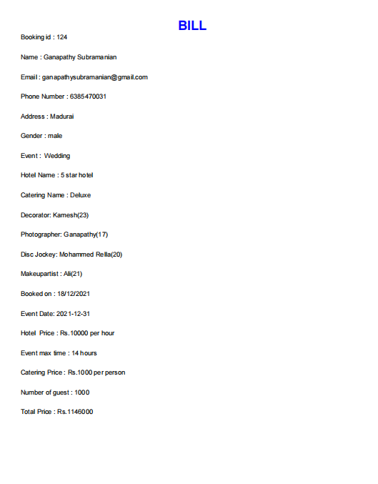

Slide 28
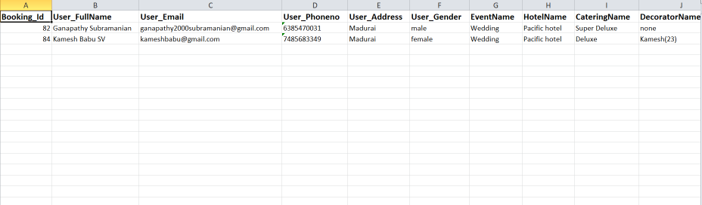

Slide 29
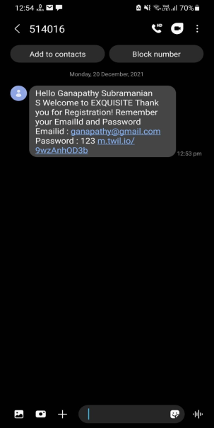

Slide 30
THANK YOU

